Slide 1
Concept of Product and Services

Slide 2


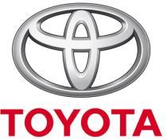

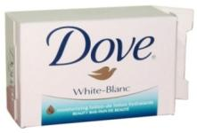

What Is a Product/ Goods?
Product/Goods is anything that can be offered in a market for attention, acquisition, use, or consumption that might satisfy a need or want of the customer.
-Physical Goods; like Soap, Shampoo, Toothpaste, Biscuits, Soft drinks etc.

Slide 3







What Is a Service?
-Service is a form of product that consists of activities, benefits, experience or satisfactions offered for sale that are essentially intangible and do not result in ownership of anything.
Telecom companies, Hotels, Banks, Insurances, Hospitals, Airlines etc.

Slide 4


Introduction to Services…
Services are deeds, processes and performance
Intangible, but may have a tangible component
Generally produced and consumed at the same time
Transfer of ownership not possible for service
Services once given can not be retuned back

Slide 5



According to James Fitzsimmons , “A service is a time-perishable, intangible experience performed for a customer acting in the role of a co-producer”.
Time-perishable means it can lose its usefulness and value if not appropriately stored or transported, or if not utilized within certain period. Co-producer means sometimes customers are expected to actively participate in the production process, such as in Marriage counselling, weight-reduction program, personal training.
The Characteristics of Services are;
- Intangibility
- Inseparability
- Variability
- Perishability

Slide 6
Intangibility refers to the fact that services cannot be seen, tasted, felt, heard, or smelled before they are purchased and used.
- E. g. Services of Hospitals, Air lines, Hotel and Restaurants etc.
Inseparability refers to the fact that services cannot be separated from their providers.
- E. g. Services from Doctors, Lawyers or any other Consultants cannot be separated.

Slide 7
Variability refers to the fact that service quality depends on who provides it as well as when, where, and how it is provided.
- E. g. Because of different person, place & time services may vary from a same organization.
Perishability refers to the fact that services cannot be stored for later sale or use.
- E. g. When a concert or any cultural event is finished, organizer can not sale the empty seats.

Slide 8
Goods vs Service
Characteristic | Goods | Service
Customer contact | Low | High
Uniformity of input | High | Low
Labor content | Low | High
Uniformity of output | High | Low
Output | Tangible | Intangible
Measurement of productivity | Easy | Difficult
Opportunity to correct problems | High | Low
Inventory | Much | Little
Evaluation | Easier | Difficult
Patentable | Usually | Not usual

Slide 9
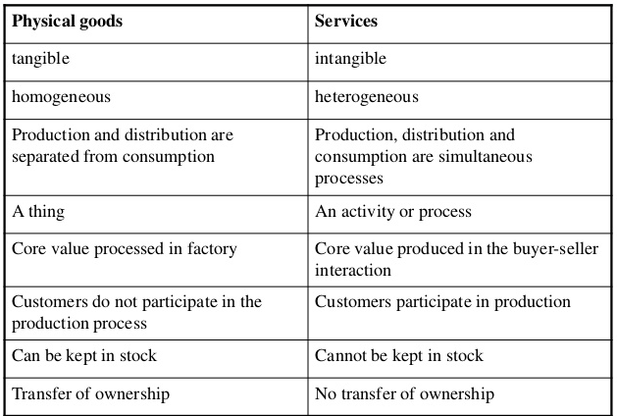
Goods Vs Service

Slide 10
Analysis
Analysis is the complete analysis of the company’s situation in a SWOT analysis that evaluates the company’s:
Strengths
Weaknesses
Opportunities
Threats

Slide 11
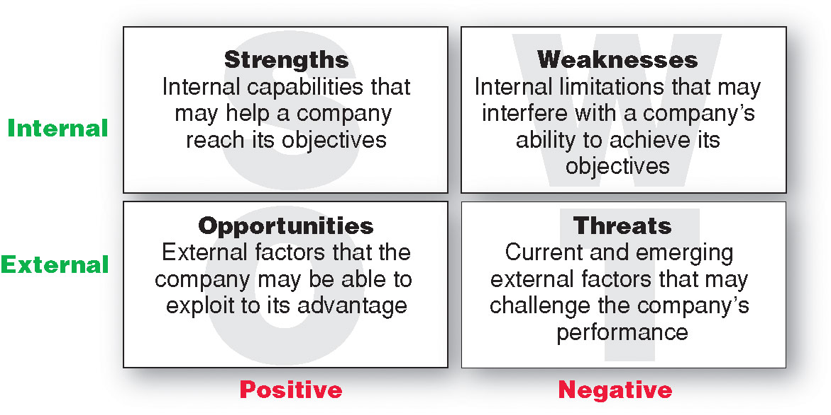
SWOT Analysis

